Slide 1

Temporal Analysis Performant Evolution
to positively empower enterprise with the INSIGHTS needed to win
https://github.com/shawnmccarthy/TEMPORAL
https://github.com/shawnmccarthy/TEMPORAL/projects/1

Slide 2

A) Research: TCN
Time series analysis is widely used in fields such as business, economics, finance, science, and engineering.
Our approach seeks to identify shifting economic phase and provide a framework for making asset allocation decisions according to the probability that asset may outperform or underperform.
Temporal Convolutional Networks have recently been applied to time series data where longer term memory of seasonality of the dataset are required
Research Encoder/Decoder and Knowledge Driven Event Embedding

Slide 3

Schedule
Week | Topic | Output
1 | Temporal Convolutional Network Analysis https://github.com/unit8co/darts | Schedule
2/3 | Standard TCN - Dilated Convolutional Layers https://towardsdatascience.com/temporal-coils-intro-to-temporal-convolutional-networks-for-time-series-forecasting-in-python-5907c04febc6 https://github.com/philipperemy/keras-tcn https://www.frbsf.org/economic-research/indicators-data/daily-news-sentiment-index/ | Stock Macro and Sector data
4/5 | Deep TCN http://www.gm.fh-koeln.de/ciopwebpub/Thill20a.d/bioma2020-tcn.pdf | Stock Macro and Sector data
6/7 | N-BEAT - Neural Basis Expansion Analysis Time Series Forecasting https://unit8co.github.io/darts/examples/07-NBEATS-examples.html | Stock Macro and Sector data
8/9 | Temporal Fusion Transformer https://ai.googleblog.com/2021/12/interpretable-deep-learning-for-time.html https://towardsdatascience.com/temporal-fusion-transformer-a-primer-on-deep-forecasting-in-python-4eb37f3f3594 https://unit8co.github.io/darts/examples/13-TFT-examples.html | Stock Macro and Sector data
10 | Spring Break
11/12/13 | Goal: Best Network for Temporal prediction of time series data (e.g. market data) | Summary of results

Slide 4
Schedule
Week | Topic | Output
14/15 | Knowledge-Driven Based event embedding Paulheim (2016) http://www.semantic-web-journal.net/system/files/swj1167.pdf | Design of embedding
16 | Prepare for phase 2

Slide 5
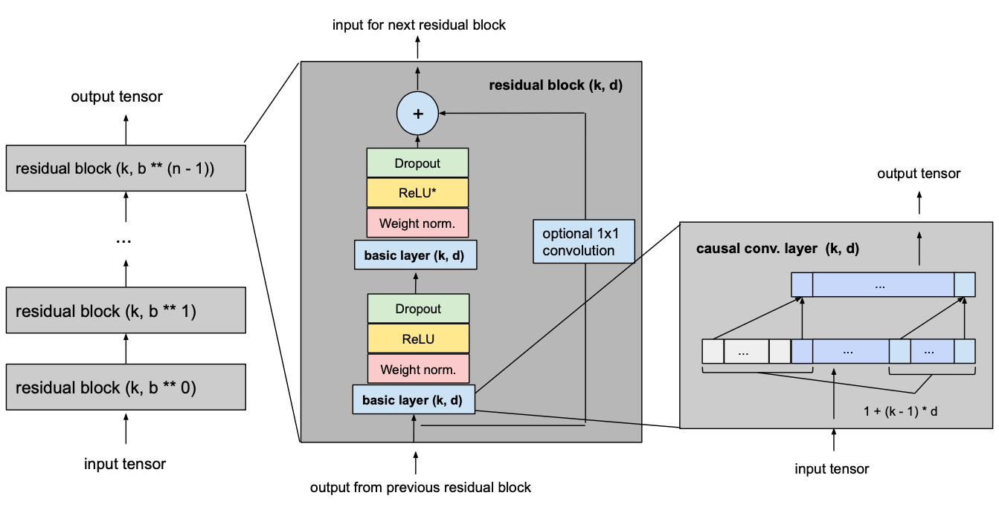
TCN Basic model
Given input_length, kernel_size, dilation_base and the minimum number of layers required for full history coverage, TCN network would look something like this
Consists of dilated, causal 1D convolutional layers with the same input and output lengths

Slide 6
Hyper Parameters
Weekly forecast
model = TCNModel( input_chunk_length=365, output_chunk_length=7, n_epochs=50, dropout=0.2, dilation_base=2, weight_norm=True, kernel_size=5, num_filters=8, nr_epochs_val_period=1, random_state=0, )
Periods to wait for Loss
Random weights
Notes:
To normalize the input of hidden layers (which counteracts the exploding gradient problem among other things), weight normalization is applied to every convolutional layer.
In order to prevent overfitting, regularization is introduced via dropout after every convolutional layer in every residual block. The following figure shows the final residual block.

Slide 7
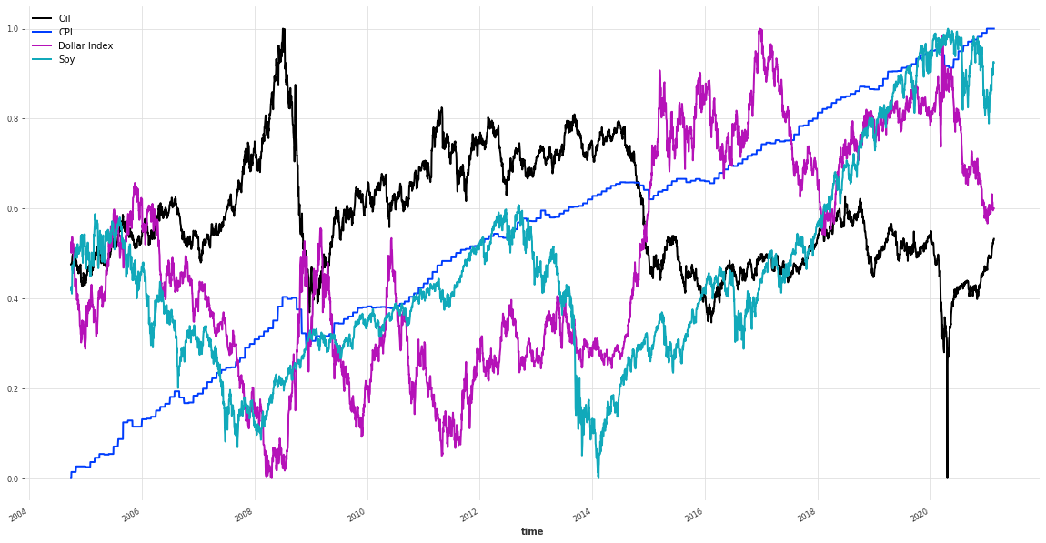
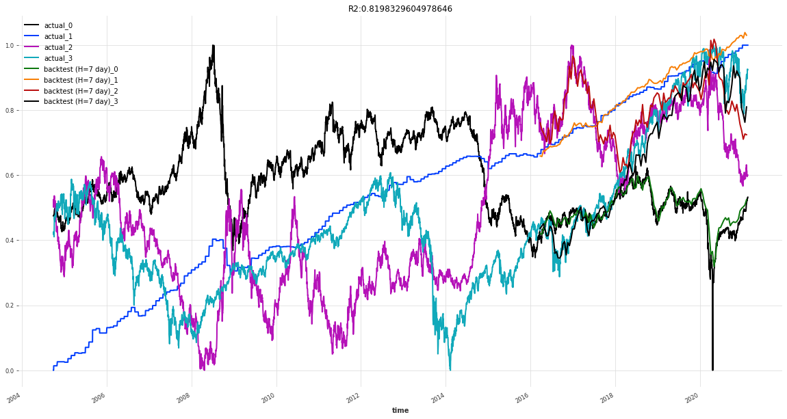
Oil, CPI, Dollar Index
Backtest RMSE = 0.03857457909272441
Notes:
R2 (coefficient of determination) regression score function.
It takes a time series, a starting point (here, we are starting at half of the series) and a forecast horizon. It returns the TimeSeries containing the historical forecasts would have been obtained when using the model to forecast the series with the specified forecast horizon (here 3 months), starting at the specified timestamp (using an expanding window strategy).

Slide 8

What’s Happened
Compare different hyper parameter sets to get a better understanding of kernel and dilation towards network and loss
Review covariate approach to pull in one additional knowledge

Slide 9
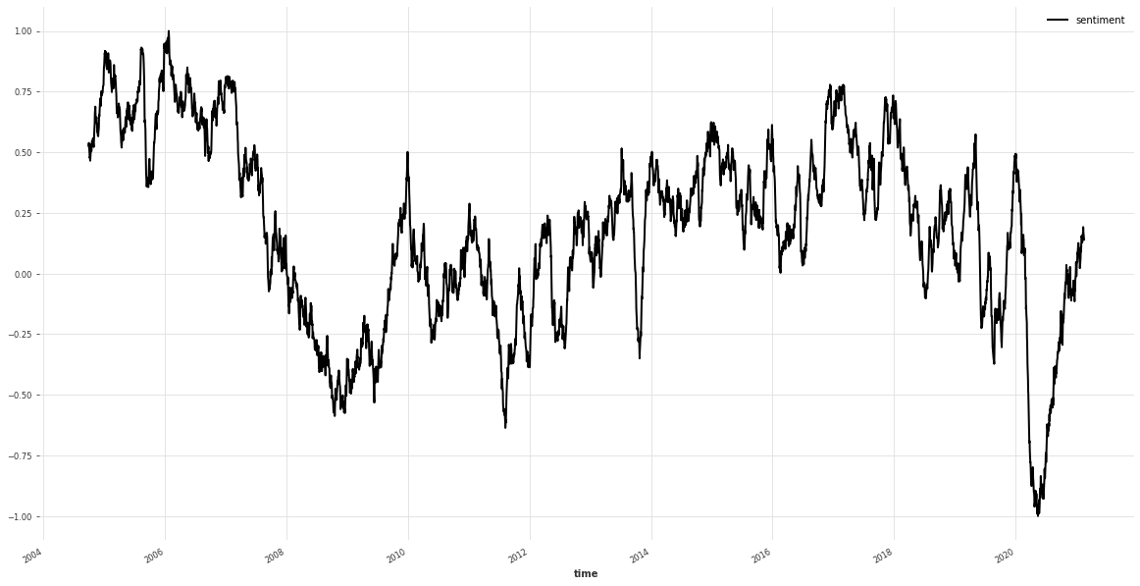




News sentiment
References
Buckman, Shelby R., Adam Hale Shapiro, Moritz Sudhof, and Daniel J. Wilson. 2020. “News Sentiment in the Time of COVID-19.” FRBSF Economic Letter 2020-08 (April 6).
Shapiro, Adam Hale, Moritz Sudhof, and Daniel J. Wilson. 2020. “Measuring News Sentiment.” FRB San Francisco Working Paper 2017-01.
The Data tab contains a news sentiment measure from January 1, 1980, to the latest day available.
$$s_{a}^{i}=f_{t(a)}^{i}+f_{p\left(a\right), j\left(a\right)}^{i}+ε_{a}^{i}$$
$$s_{a}^{i}$$
is the positivity score for article
is a sample-day (t) fixed effect
is a newspaper*type fixed effect
$$f_{t(a)}^{i}$$
$$f_{p\left(a\right), j(a)}^{i}$$

Slide 10
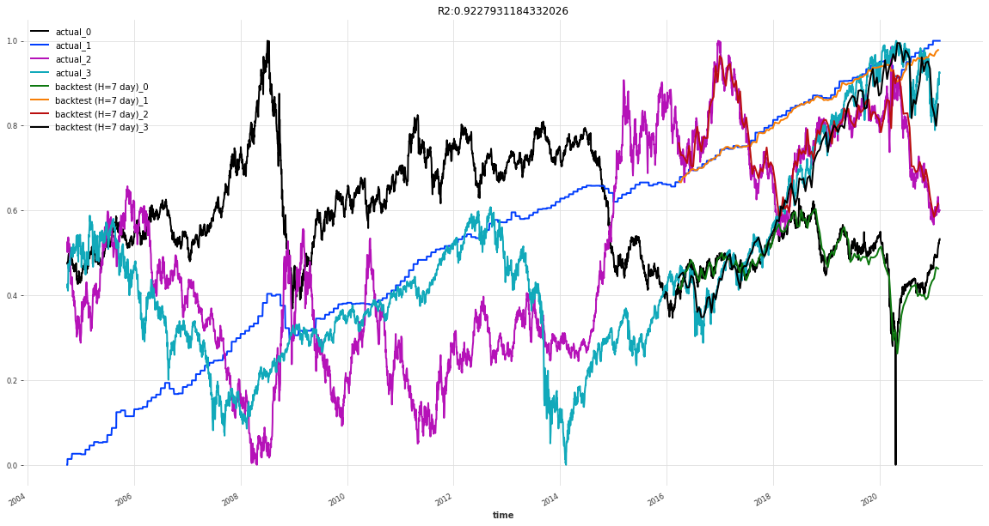
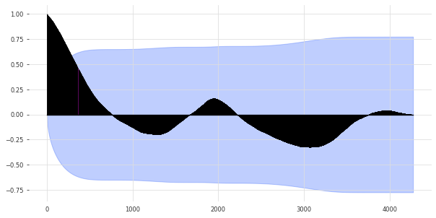
With covariate News
Backtest RMSE = 0.024682999973297988
seasonality = check_seasonality( ["Spy"], max_lag=len(series))
(True, 1943) = 5.3 years (*2018 - growing economy on average 3.2 years, recession 1.5 years)
Notes:
Plot the autocorrelation function
Plots lags on the horizontal and the correlations on vertical axis.

Slide 11
Different models
tcn_model(5, 2, train, val)
tcn_model(5, 2, train, val, train_cov, val_cov)

Slide 12
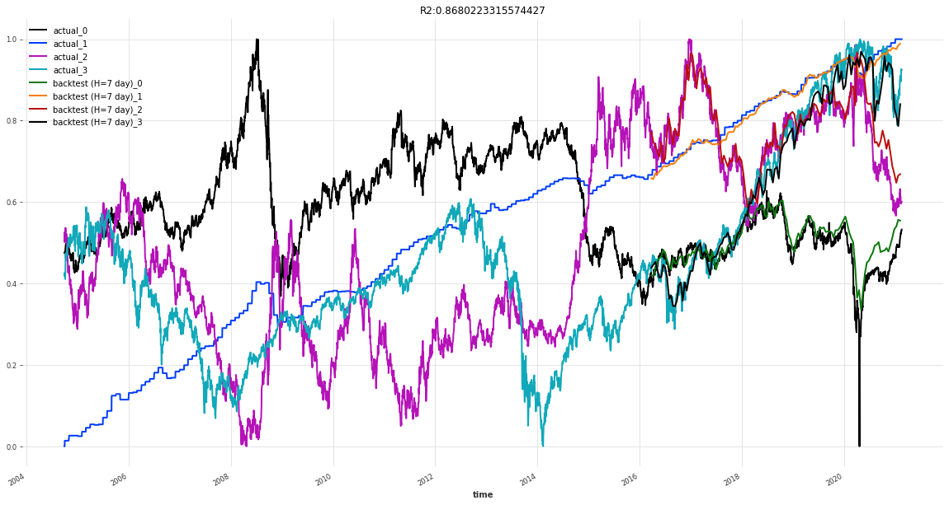

Different models
tcn_model(3, 2, train, val)
tcn_model(3, 2, train, val, train_cov, val_cov)

Slide 13
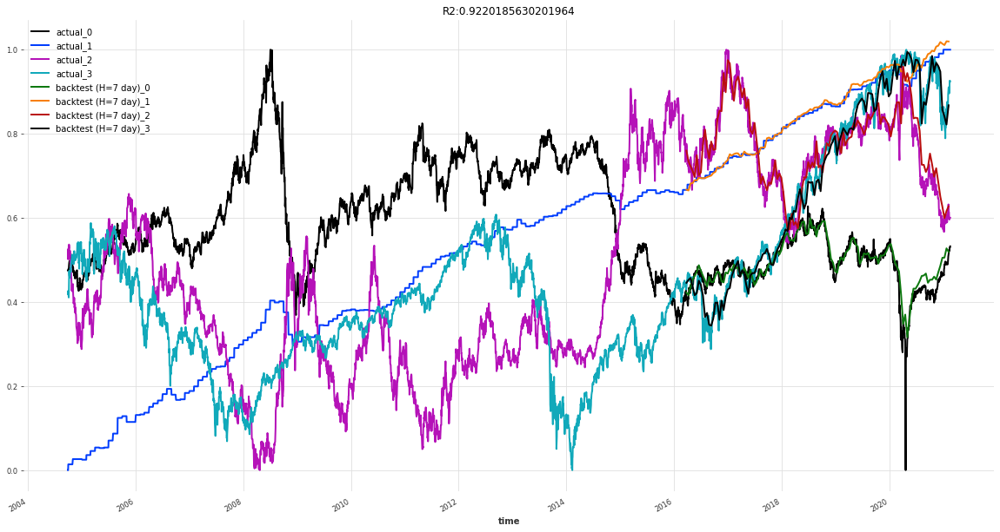
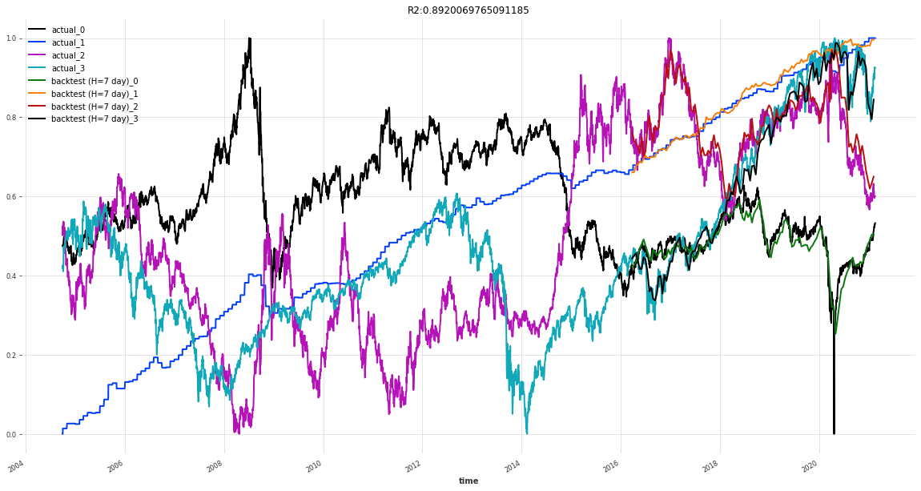
Different models
tcn_model(7, 2, train, val)
tcn_model(7, 2, train, val, train_cov, val_cov)

Slide 14
TCN Model
DeepTCN Models
Probabilistic forecasting using TCN model with Likelihood - GaussianLikelihood()

Slide 15
Guassian likelhoold
https://arxiv.org/pdf/1906.04397.pdf
Probabilistic Forecasting with Temporal Convolutional Neural Network
Yitian Chena , Yanfei Kangb,∗ , Yixiong Chenc , Zizhuo Wangd
Probabilistic forecasting framework based on convolutional neural network
Probabilistic forecasts of future observations can be achieved by directly predicting the parameters of the hypothetical distribution (e.g., the mean and the standard deviation for Gaussian distribution) based on maximum likelihood estimation

Slide 16
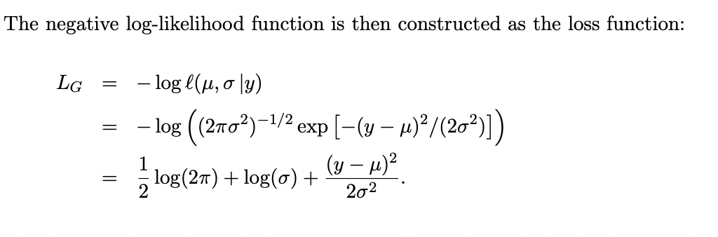
Parameter approach
Authors take Gaussian distribution as an example, for each target value y, the network outputs the parameters of the distribution, namely the mean and the standard deviation, denoted by µ and σ, respectively

Slide 17
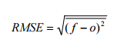
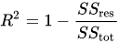
Comparison
 | 5/2 | 5/2 news | 3/2 | 3/2 news | 7/2 | 7/2 news
 | rsme --- R2 | rsme --- R2 | rsme --- R2 | rsme --- R2 | rsme --- R2 | rsme --- R2
TCN | 0.0385 --- 0.8198 | 0.0246 ---- 0.9227 | 0.0291 ---- 0.8680 | 0.0302 ---- 0.8694 | 0.0242 ---- 0.9220 | 0.0292 ---- 0.8920
TCN - Gaussian | 0.0248 --- 0.9187 | 0.0249 ---- 0.9119 | 0.0241 ---- 0.9183 | 0.0239 ---- 0.9273 | 0.0329 ---- 0.8737 | 0.0225 ---- 0.9289
Notes:
In statistics, the coefficient of determination, denoted R² or r² and pronounced "R squared", is the proportion of the variation in the dependent variable that is predictable from the independent variable(s).
1 would be perfect
Root Mean Squared Error (RMSE).
sum of squares of residuals / total sum of variances
Simply put between the observed outcomes and the observed predictor values
Here is my question MASE (Mean Absolute) or SMAPE symmetric Mean Absolute Percentage Error

Slide 18
What's next
N-Beats
Generic - uses as little prior knowledge as possible, with no feature engineering, no scaling and no internal architectural components
interpretable architecture consisting of two stacks: A trend stack and a seasonality stack. The architecture is designed so that:
The trend component is removed from the input before it is fed into the seasonality stack
The partial forecasts of trend and seasonality are available as separate interpretable outputs

Slide 19
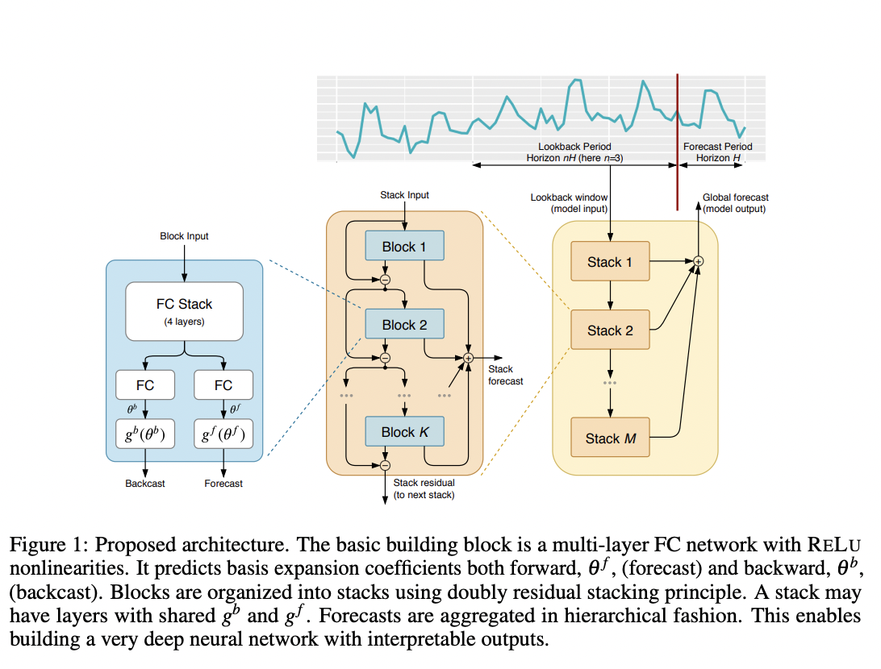
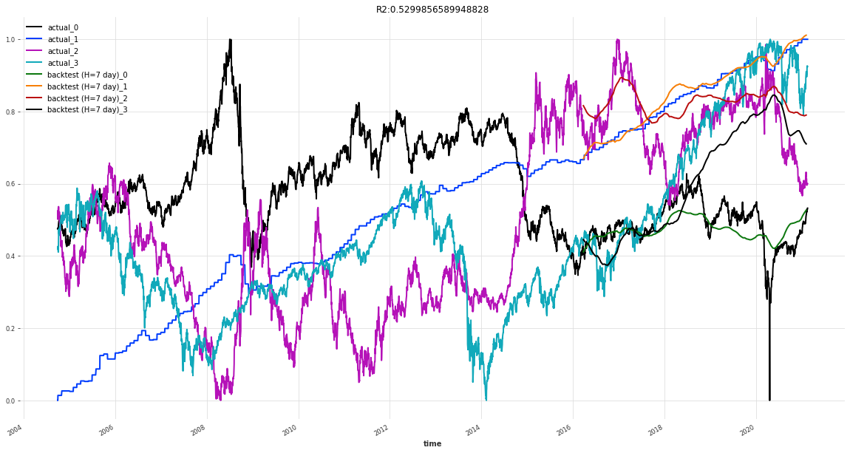
N-beats NEURAL BASIS EXPANSION ANALYSIS FOR INTERPRETABLE TIME SERIES FORECASTING
https://arxiv.org/pdf/1905.10437.pdf
Notes:
The generic architecture does not rely on TS-specific knowledge.
The interpretable architecture can be constructed by reusing the overall architectural approach in Fig. 1 and by adding structure to basis layers at stack level. Forecasting practitioners often use the decomposition of time series into trend and seasonality,
R square can have a negative value when the model selected does not follow the trend of the data, therefore leading to a worse fit than the horizontal line.

Slide 20
Comparison
 | 1/4/10 Block/ layer/ stack | 1/4/10 news | 3/4/10 | 3/4/10 news | 7/4/10 | 7/2 news
 | rsme --- R2 | rsme --- R2 | rsme --- R2 | rsme --- R2 | rsme --- R2 | rsme --- R2
N-BEATS | 0.2618 --- -8.9508 | 0.1718 ---- -6.8629 | 0.2372 ---- -4.7372 | 0.2022 ---- -4.2964 | 0.1859 ---- -1.5329 | 0.1637 ---- -2.595
N-BEATS Classic | 0.1044 -- -0.2296 | 0.1270 -- -0.3730 | 0.0796 -- 0.0281 | 0.1272 -- -0.9829 | 0.1201 -- -0.2906 | 0.1038 -- 0.0430
Notes:
In statistics, the coefficient of determination, denoted R² or r² and pronounced "R squared", is the proportion of the variation in the dependent variable that is predictable from the independent variable(s).
1 would be perfect
Root Mean Squared Error (RMSE).
sum of squares of residuals / total sum of variances
Simply put between the observed outcomes and the observed predictor values
Here is my question MASE (Mean Absolute) or SMAPE symmetric Mean Absolute Percentage Error

Slide 21
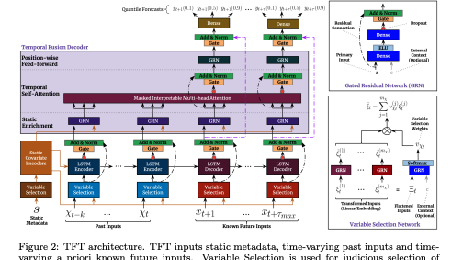
What's next
TFTModel incorporates the following main components from the original Temporal Fusion Transformer (TFT) architecture as outlined in this paper: https://arxiv.org/pdf/1912.09363.pdf
gating mechanisms: skip over unused components of the model architecture
variable selection networks: select relevant input variables at each time step.
temporal processing of past and future input with LSTMs (long short-term memory)
multi-head attention: captures long-term temporal dependencies
prediction intervals: per default, produces quantile forecasts instead of deterministic values
Notes:
– a novel attentionbased architecture which combines high-performance multi-horizon forecasting with interpretable insights into temporal dynamics.
To learn temporal relationships at different scales, TFT uses recurrent layers for local processing and interpretable self-attention layers for long-term dependencies.
Explainable

Slide 22
Lessons Learned Last time
Sector | Expand Before Peak | Peak | Contraction After Peak | Trough | Expansion After Trough
Real-estate | + | - | - | - | +
Technology | + | + | - | - | +
Industrials | + | + | - | - | +
Oil | - | + | + | - | -
Consumer | + | + | - | + | +
The biggest surprise in this analysis is the explainable AI features that drive importance of the business cycle over the last two cycles. This shows that the indicators of CPI, Technology, Real-estate, Industrials and Oil as being good indicators of overall analysis of the business cycle.
Notes:
A business cycle approach to asset allocation can add additional insights as part of a intermediate to longer term strategy. Although each business cycle is different, this analysis suggests that there is a cyclical pattern in the economy and performance in asset categories in the macro and sector do show some correlation.
The biggest surprise in this analysis is the explainable AI features that drive importance of the business cycle over the last two cycles. This shows that the indicators of CPI, Technology, Real-estate, Industrials and Oil as being good indicators of overall analysis of the business cycle.
Indicator
Description
CPI (Macro) Consumer price index measure changes in the price level of a weighted average market basket of consumer goods and services purchases by households
Technology (Sector) Price and yield performance of publicly traded equity securities of companies in the technology select sector index.
Real estate (Sector) Price and yield performance of publicly traded equity securities of companies that purchase office building, hotels and other real property.
Industrials (Sector) Tracks the stocks of some of the largest companies in the US economy; large CAP US equities (e.g. MSFT, BA, HD, AMGN, UNH, DIS, JNJ)
Oil (Macro) Crude oil prices
When combined with the analysis we see the relative performance therefore having business cycle insights can provide insights into more economically sensitive sectors as related to more defensively oriented sectors.
Early – expand before peak - Sectors that typically benefit most from low interest rates—such as consumer discretionary, financials, and real estate which we also see in our analysis
Peak – during this phase the technology stocks
Contraction shows that Oil and by proxy energy stocks to do
Recession shows that consumer staples tend to do better – where revenues are tied to basic needs
Expansion after trough matches the expand before peak
Economic researchers (Ibbotson et al.) state that economic factors influence asset prices, however there is still research required to determine the best way to incorporate economic factors into asset allocation approaches. The impact of the pandemic entered the US into a contraction after peak cycle that was not influenced by other economic factors. There is debate whether we should have eliminated that period from the analysis however it still provides valuable insights to the impact on sector and macro indicators. Today the problem with business cycle analysis is research centers such as NBER are not timely in their analysis (their last announcement of recession was a full 12 months after the fact). Leveraging the full AI model with the 12 data sources continues to predict that we are still in the contraction after peak phase of the business cycle. We believe with a disciplined business cycle approach that we can better predict the natural phases of the economy and better analyze the underlying factors and trends across various time horizons through the use of both macro and sector data sources.

Slide 23
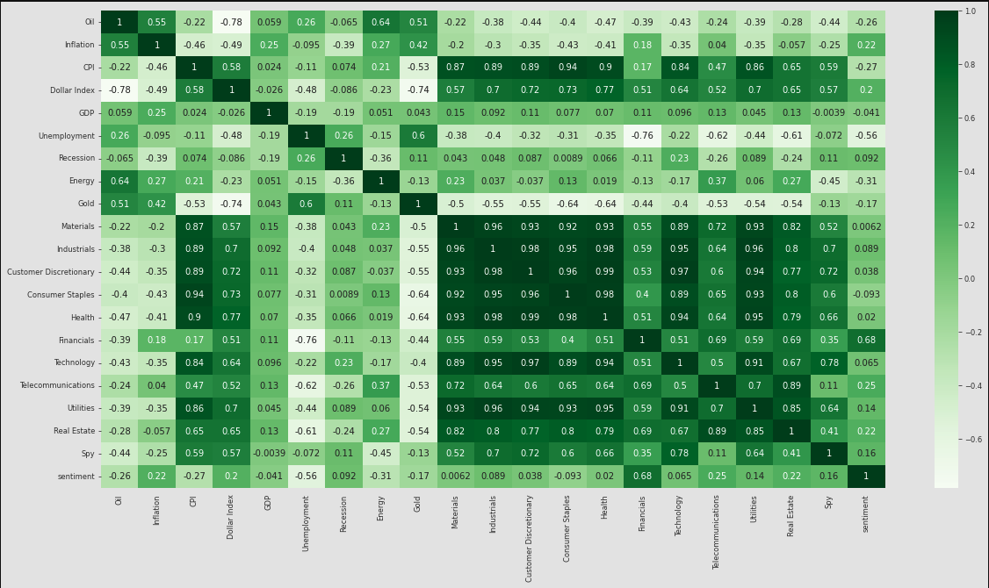
Correlation
Economic sentiment
World conflict?
Oil?
Industrials?
Technology?
Look at multidimensional on sentiment (not just positive/negative)
– are there elements beyond an aggregate sentiment?

Slide 24


Final Concept
Genetic Algorithms applied to Temporal Convulsion Networks
Temporal Analysis Performant Evolution

Slide 25
Initial thoughts
A) Research: Temporal Convolutional Network
Dilated Convolutional Layers
Encoder/Decoder
B) Research: Genetic Algorithms
Apply to layers and hyper parameters
C) Applied: TCN – Performant Evolution – Supervised
Apply TCN network design and genetic algorithm approach to time series problem
Goal: Best Network for Temporal prediction of time series information (e.g. market data)
Output experiments across more recent designs (encoder/decoder)
Goal: Determine best genetic algorithms that can be applied (parameter tuning, black-box, binary gene encoding, adaptive) and fitness functions to apply
Output experiments across different genetic algorithms
Goal: Compare backpropagation to evolutionary approach
Output experiments across
D) Applied: TCN – Performant Evolution – Including Events
Knowledge driven events (negative effects causing abrupt changes)
Continuous learning (stream real-time data)
Output experiments across more recent designs (knowledge graphs / news events / current stock data)
Incorporate abrupt model (negative effect)

Slide 26
A) Research: TCN
Time series analysis is widely used in fields such as business, economics, finance, science, and engineering.
Our approach seeks to identify shifting economic phase and provide a framework for making asset allocation decisions according to the probability that asset may outperform or underperform.
Temporal Convolutional Networks have recently been applied to time series data where longer term memory of seasonality of the dataset are required
Research Encoder/Decoder and Knowledge Driven Event Embedding

Slide 27
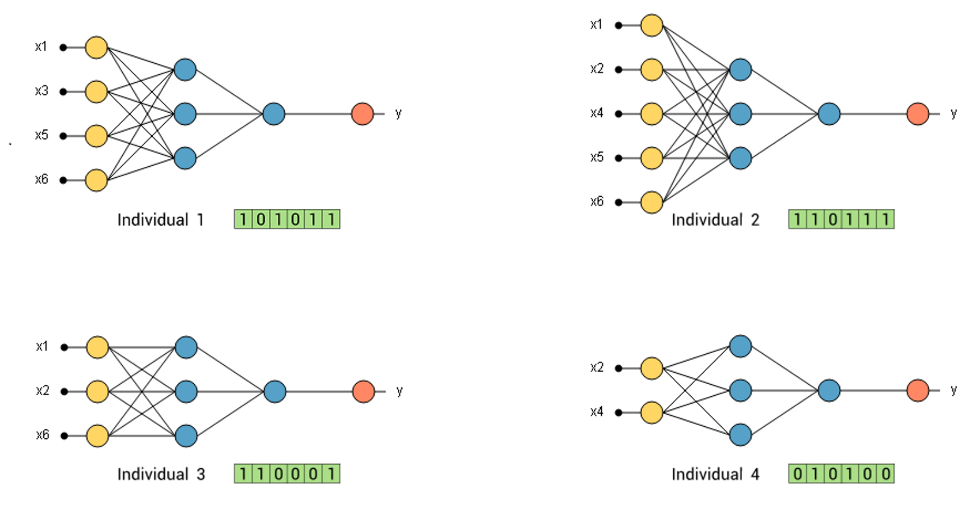
B) Research: GA
The most common task to find parameters at which a particular function reaches its maxima value
Black-box
Gene Encoding
Adaptive GA
Determine fitness function and architecture of genetic algorithms
Can an adaptive approach to selecting GA parameters be applied

Slide 28
C) Applied: E-TCN
Can TCN networks design and hyper parameters be optimized through evolutionary techniques?
Does a genetic algorithm perform better with high-dimensional and seasonal big data challenges such as market data?
Can we improve accuracy and performance of the deep neural networks?
Apply TCN network design and genetic algorithm approach to time series problem
Goal: Compare backpropagation to evolutionary approach
Output experiments across

Slide 29
D) Applied: E-TCN
Can Knowledge driven events that cause abrupt changes be incorporated into the model?
Can an adaptive continuous learning adaptive approach be applied (streaming market data and news data)?
Results of experiments in complete design
Knowledge driven events (negative effects causing abrupt changes)
Incorporate abrupt model (negative effect)
Continuous learning (stream real-time data)
Output experiments across more recent designs (knowledge graphs / news events / current stock data)

Slide 30
Appendix
Charts

Slide 31
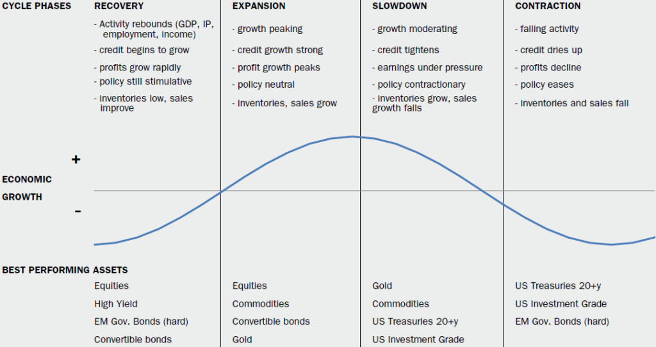
Problem statement prediction
Our approach seeks to identify shifting economic phase and provide a framework for making asset allocation decisions according to the probability that asset may outperform or underperform.
In intermediate-term how is asset performance driven by interest rates and inflation?
Can we determine sector performance based on the business cycle (early, mid, late, recession)?
Can we manage extrapolation bias (too much emphasis on recent price movements)?
Can we improve accuracy of phase identification?
Notes:
Over the intermediate term, asset performance is often driven largely by cyclical factors tied to the state of the economy—such as corporate earnings, interest rates, and inflation. The business cycle, which encompasses the cyclical fluctuations in an economy over many months or a few years, can therefore be a critical determinant of asset market returns and the relative performance of various asset classes.
Specifically, there are 4 distinct phases of a typical business cycle (see chart below):
Early-cycle phase: Generally a sharp recovery from recession, marked by an inflection from negative to positive growth in economic activity (e.g., gross domestic product, industrial production), then an accelerating growth rate. Credit conditions stop tightening amid easy monetary policy, creating a healthy environment for rapid margin expansion and profit growth. Business inventories are low, while sales growth improves significantly.
Mid-cycle phase: Typically the longest phase of the business cycle. The mid cycle is characterized by a positive but more moderate rate of growth than that experienced during the early-cycle phase. Economic activity gathers momentum, credit growth becomes strong, and profitability is healthy against an accommodative—though increasingly neutral— monetary policy backdrop. Inventories and sales grow, reaching equilibrium relative to each other.
Late-cycle phase: Often coincides with peak economic activity, implying that the rate of growth remains positive but slows. A typical late-cycle phase may be characterized as an overheating stage for the economy when capacity becomes constrained, which leads to rising inflationary pressures. While rates of inflation are not always high, rising inflationary pressures and a tight labor market tend to crimp profit margins and lead to tighter monetary policy.
Recession phase: Features a contraction in economic activity. Corporate profits decline and credit is scarce. Monetary policy becomes more accommodative and inventories gradually fall despite low sales levels, setting up for the next recovery.

Slide 32
Dataset – Federal reserve
Oil | Inflation | CPI | Dollar Index | GDP | Unemployment | Business Cycle
Table that shows all macro, all sector and broad asset classes
Crude Oil (https://fred.stlouisfed.org/series/DCOILWTICO) – 1986 - 2021
Dollars per barrel
Inflation (https://fred.stlouisfed.org/series/T10YIE) -2003 .- 2021
The latest value implies what market participants expect inflation to be in the next 10 years, on average
CPI (https://fred.stlouisfed.org/series/CPIAUCSL) - 1947 – 2021
A measure of the average monthly change in the price for goods and services paid by urban consumers between any two time periods. It can also represent the buying habits of urban consumer
Trade Weighted Dollar Index (https://fred.stlouisfed.org/series/DTWEXAFEGS) – 2006 – 2021
A measure of the US dollar to other world currencies
Real Gross Domestic Product (https://fred.stlouisfed.org/series/A191RL1Q225SBEA) – 1947 - 2021
Gross domestic product (GDP) is the value of the goods and services produced by the nation's economy less the value of the goods and services used up in production
Unemployment (https://fred.stlouisfed.org/series/UNRATE) – 1948 – 2021
The unemployment rate represents the number of unemployed as a percentage of the labor force
Recession Data (https://fred.stlouisfed.org/series/USREC) – 1854 – 2021
This time series is an interpretation of US Business Cycle Expansions and Contractions data provided by The National Bureau of Economic Research
Notes:
Key takeaways
The business cycle reflects the aggregate fluctuations of economic activity, which can be a critical determinant of asset performance over the intermediate term.
Changes in key economic indicators have historically provided a fairly reliable guide to recognizing the business cycle's 4 distinct phases—early, mid, late, and recession.
Our approach seeks to identify the shifting economic phases, providing a framework for making asset allocation decisions according to the probability that assets may outperform or underperform.
For example, the early cycle phase is typically characterized by a sharp economic recovery and the outperformance of equities and other economically sensitive assets.
This approach may be incorporated into an asset allocation framework to take advantage of cyclical performance that may deviate from longer-term asset returns.
A business cycle approach to asset allocation can add value as part of an intermediate-term investment strategy.

Slide 33
Sector data – Yahoo time series
Adding ETF sector data will provide insights on confirming the ETFs that perform better during a business cycle
https://finance.yahoo.com/etfs/
ETF | Sector
XLE (Energy Select) | Energy
GDX (Gold) | Gold Miners
XLB | Materials
DIA | Industrials
XLY | Consumer Discretionary
XLP | Consumer Staples
XLV | Health Care
XLF | Financials
XLK | Technology
IYZ | Telecommunication
XLU | Utilities
VNQ | Real estate
SPY | S&P 500

Slide 34
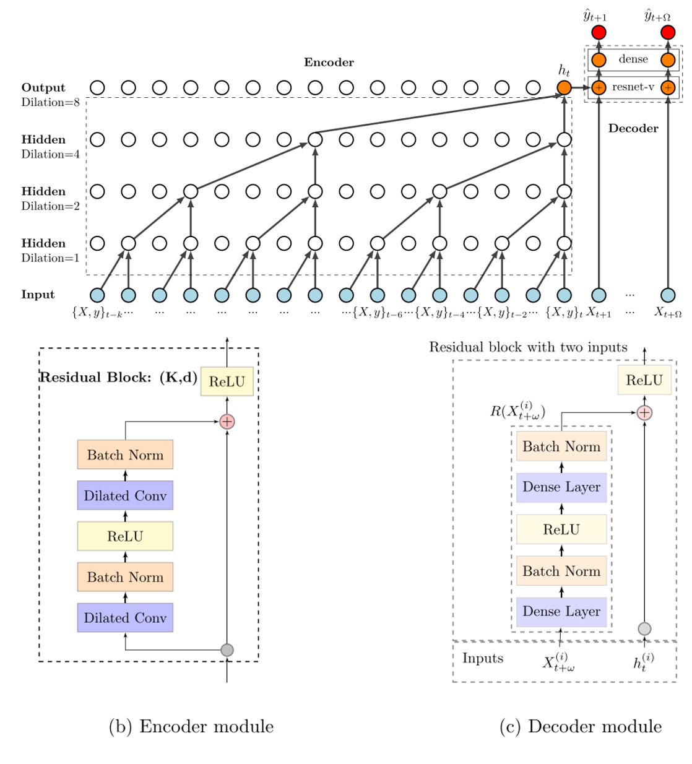
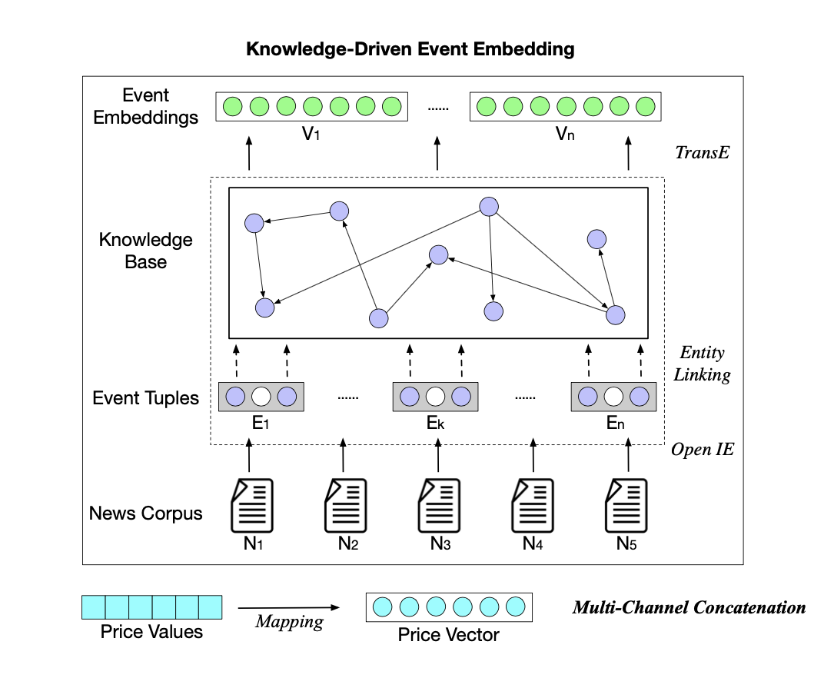
Newer concepts

